Slide 1
Is Acute Care Ageist?
Data from National A&E attendances in Scotland (Jan – Dec 17)

Slide 2
Attendance by age group
1,500,800 attendances total
327,704 over 65s (22%)

Slide 3
Odds of 4 hour breach
1/60
1/6

Slide 4
Odds of 8 hour breach
1/333
1/45

Slide 5
Odds of 12 hour breach
1/1,000
1/200

Slide 6
Is it a majors problem?

Slide 7
Is it a majors problem? Perhaps not?

Slide 8
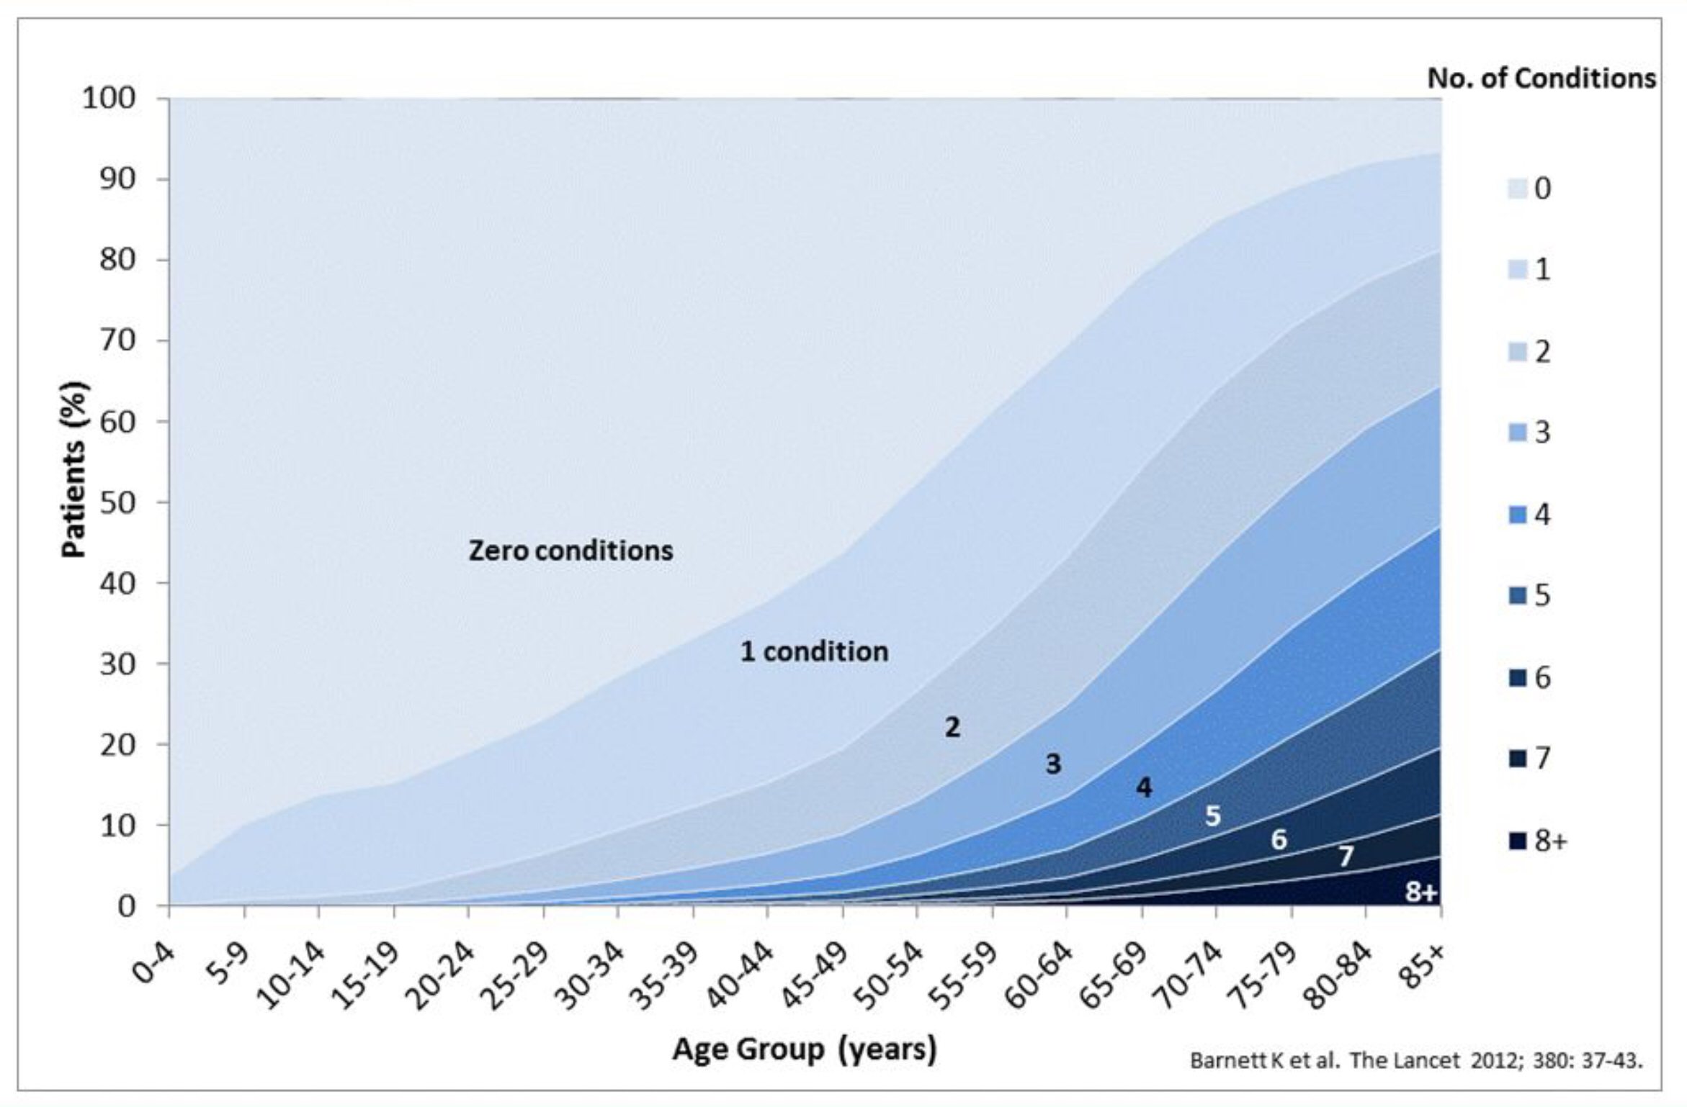
Reasons?

Slide 9
THE LIVING ENVIRONMENTS OF COMMUNITY-DWELING
OLDER PEOPLE WHO BECOME FRAIL: ANOTHER LOOK AT THE
LIVING STANDARDS OF OLDER NEW ZEALANDERS SURVEY

Slide 10
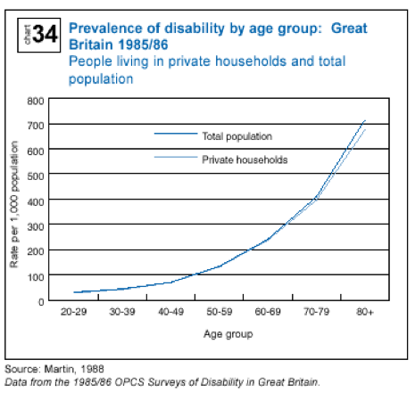

Slide 12
Lanarkshire Hospitals
1 in 44

